Slide 1
Quantifying Covertness in
Communications Systems
Lucas Rooyakkers

Slide 2
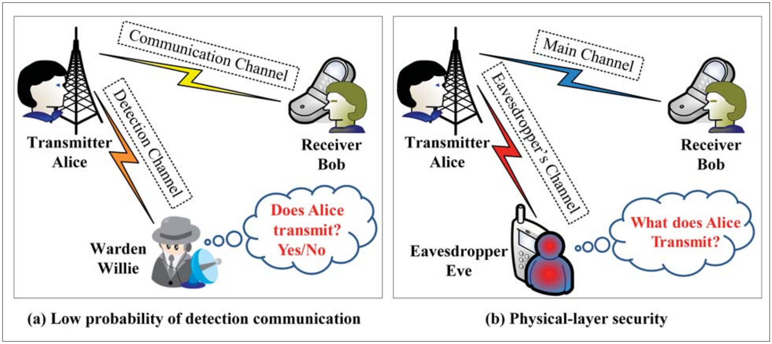
What is Covert Communications?

Slide 3
What is Covert Communications?

Slide 4
What is Covert Communications?

Slide 5
Also Known As
Low Probability of Detection (LPD)
  Used by Information Theorists
  Often formal, mathematical definition
Low Probability of Intercept (LPI)
  Used by Waveform Designers
  Describes signals that are “hard” to intercept

Slide 6
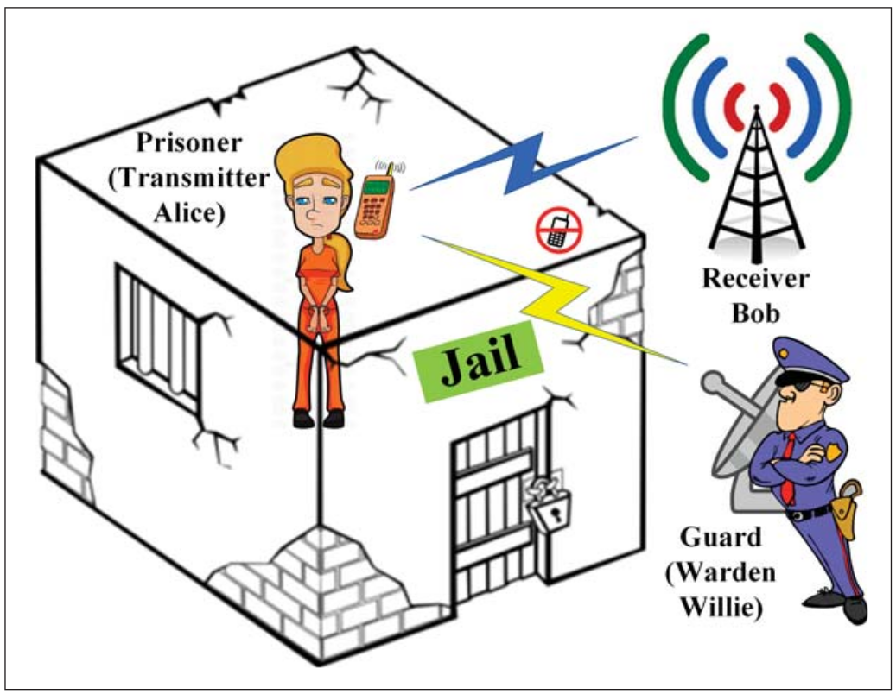
Fundamental Limits: Square Root Law
Alice can transmit O(√n) bits for every n channel uses.
Alice and Bob need a pre-shared key of O(√n)

Slide 7
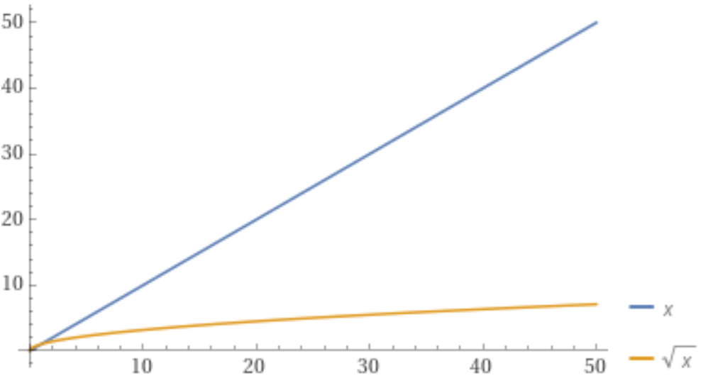
Fundamental Limits: Square Root Law
Comes from Steganography
Doesn’t grow very fast
Assumes Willie knows everything, except secret key

Slide 8
Fundamental Limits: Positive Capacity
Alice can transmit O(n) bits when:

Slide 9
Fundamental Limits: Positive Capacity
Alice can transmit O(n) bits when:
  Willie doesn’t know the noise level exactly
  Jammers are used
  There are public spectrum users

Slide 10
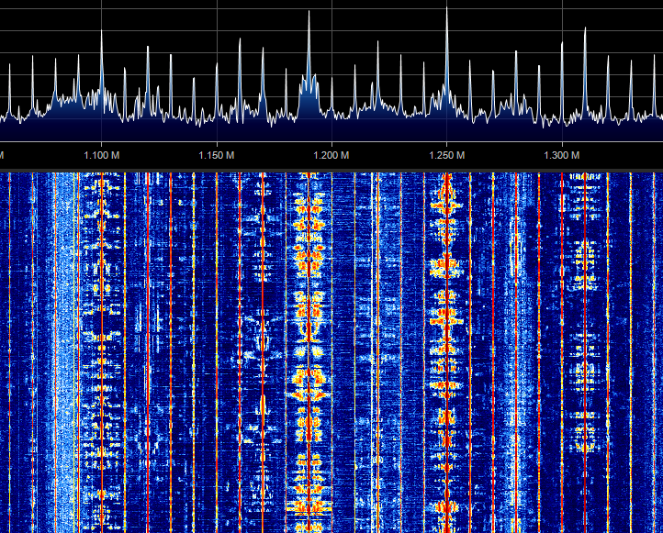
Public Messages
Alice can hide among public messages
  Willie must filter out every public message to detect Alice
  More public users means lower probability of detection

Slide 11
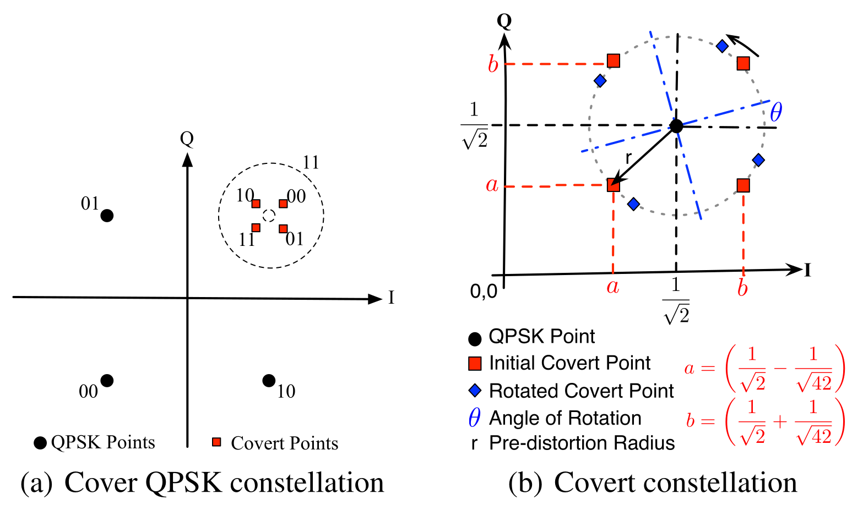
Public Messages
Alice can hide within public messages
  Alice mush know structure of public message
  Willie must filter out every public message to detect Alice

Slide 12
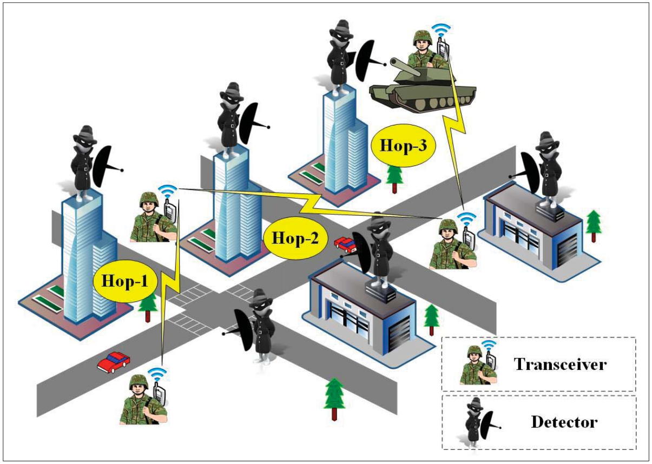
Shadow Networks

Slide 13
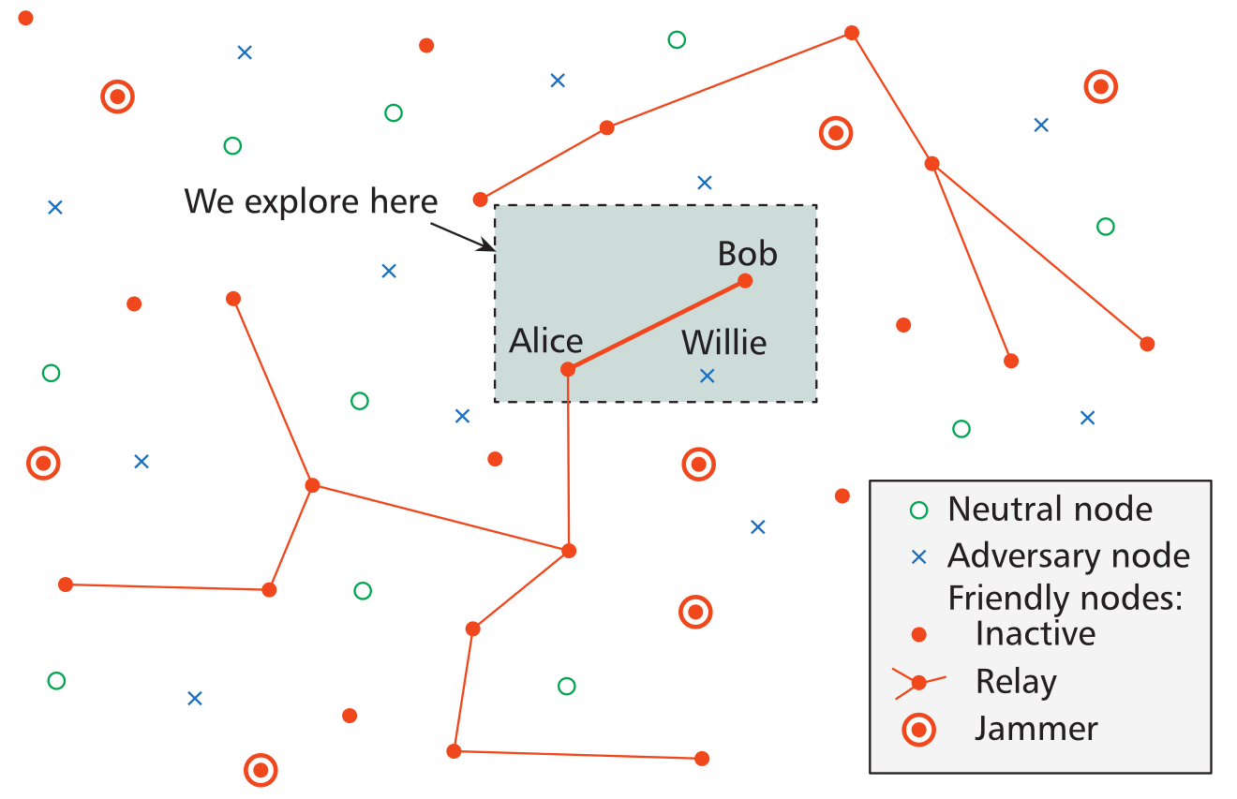
Shadow Networks
O(√n) when using undirected antennae
O(n) with beamforming, directed antennae, MIMO

Slide 14
Detector Theory: Willie’s Test

Slide 15
Detector Theory: Willie’s Test
Null Hypothesis: Only Noise
  H0: r(t) = n(t)
Alternative Hypothesis: Alice’s Signal and Noise
  H1: r(t) = n(t) + s(t)

Slide 16
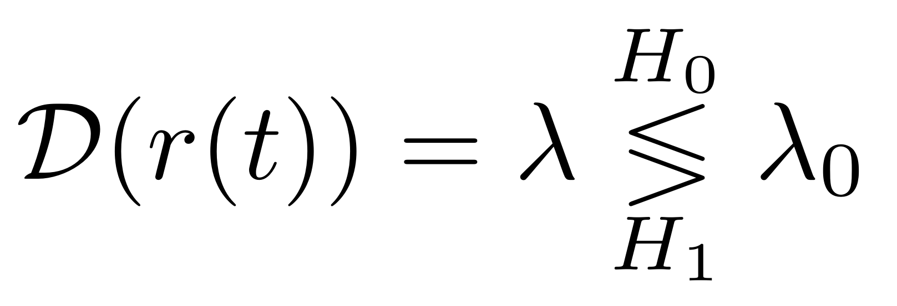
Detector Theory: Detectors
A detector takes the received signal and outputs a test statistic to be compared to a threshold:
$D\left(r\left(t\right)\right)=λ_{}$

Slide 17
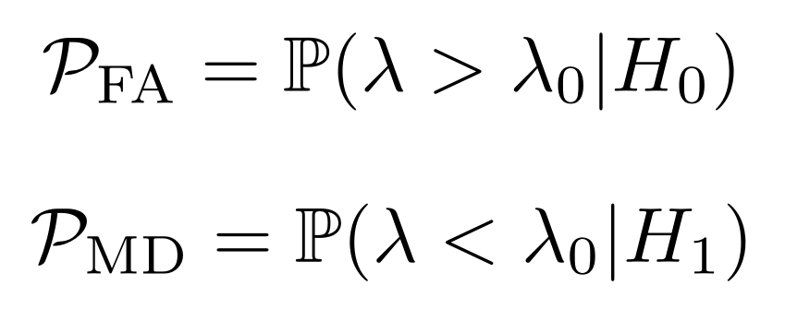
Detector Theory: Error Types
Type I (False Alarm)
Type II (Missed Detection)
$D\left(r\left(t\right)\right)=λ_{}$

Slide 18
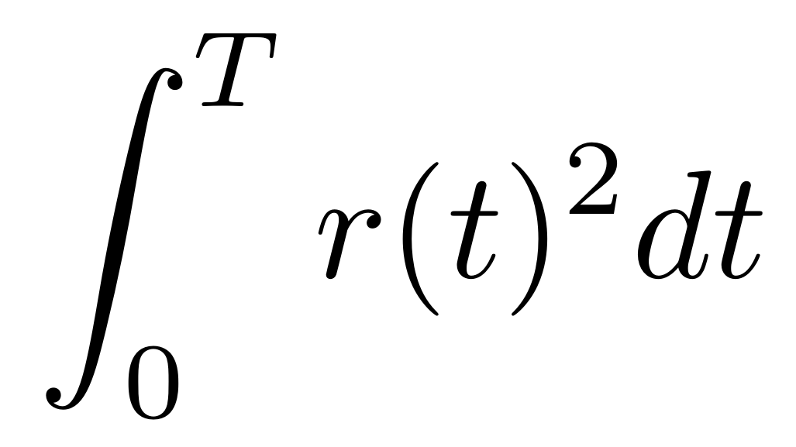
Optimal Detectors: The Radiometer
Compare measured power to noise estimate
Optimal for completely unknown signal,
on an AWGN channel
Struggles with
interference
$D\left(r\left(t\right)\right)=λ_{}$

Slide 19
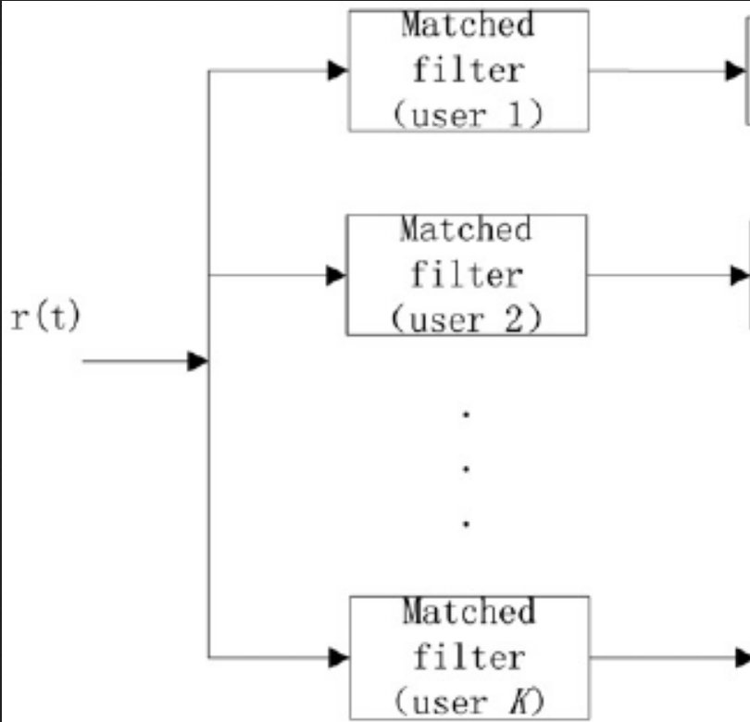
Optimal Detectors: Matched Filters
Signal properties
must be known
Can be used in a bank in
parallel
$D\left(r\left(t\right)\right)=λ_{}$

Slide 20
Cyclostationary Detectors
Checks for periodicity in signals
Best for weak signals in noise
No proven “best” metric
$D\left(r\left(t\right)\right)=λ_{}$

Slide 21
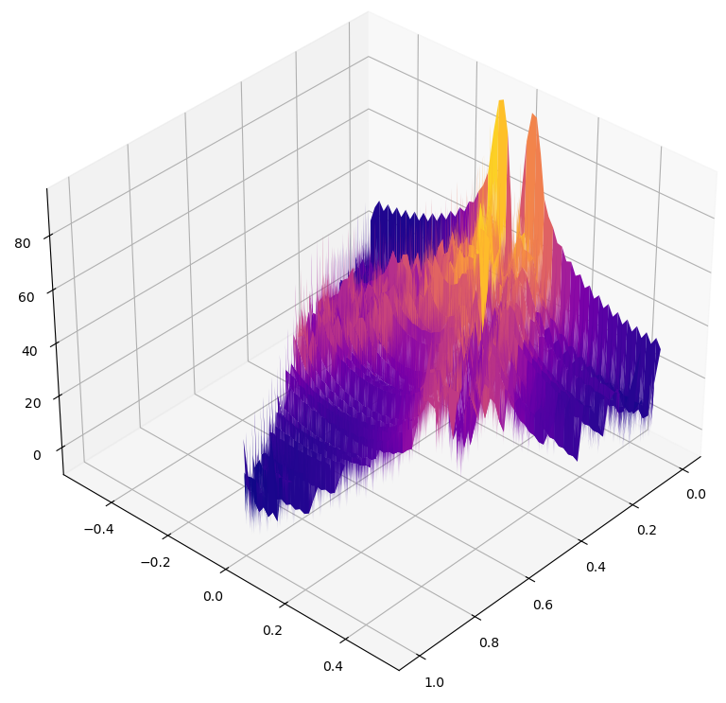
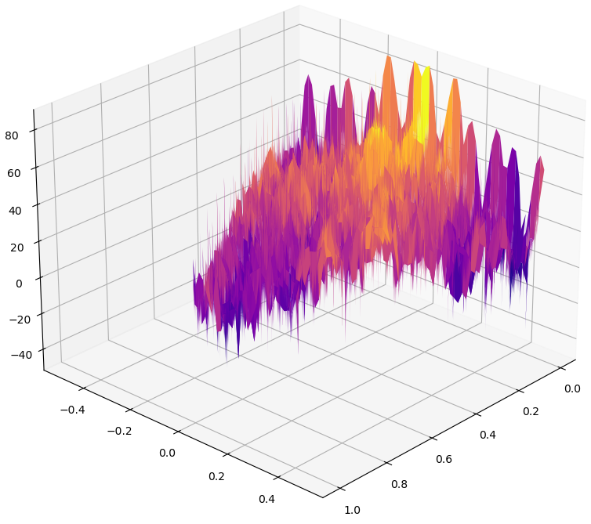
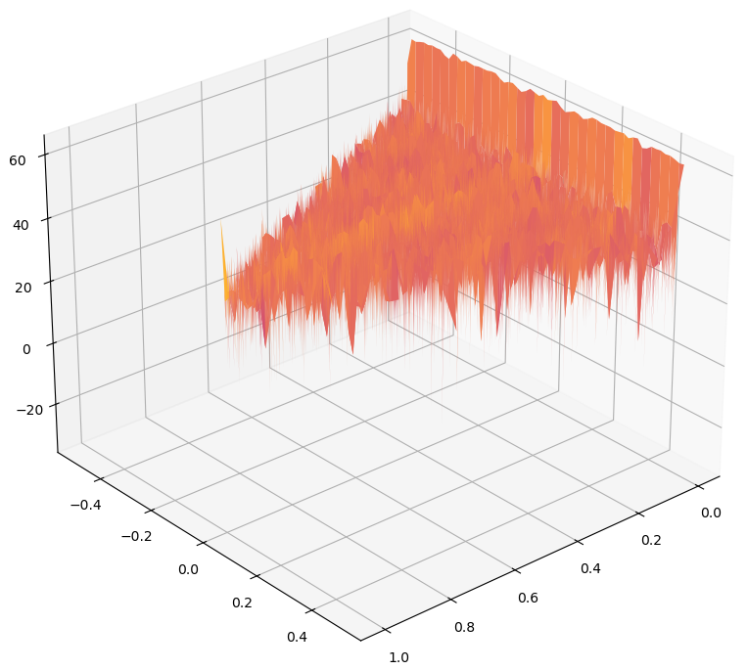
Cyclostationary Detectors
t
$D\left(r\left(t\right)\right)=λ_{}$
BPSK
CDMA-BPSK
AWGN

Slide 22
How to Create LPI/LPD Waveforms

Slide 23

How to Create LPI/LPD Waveforms
Lower the Power (at Willie)

Slide 24
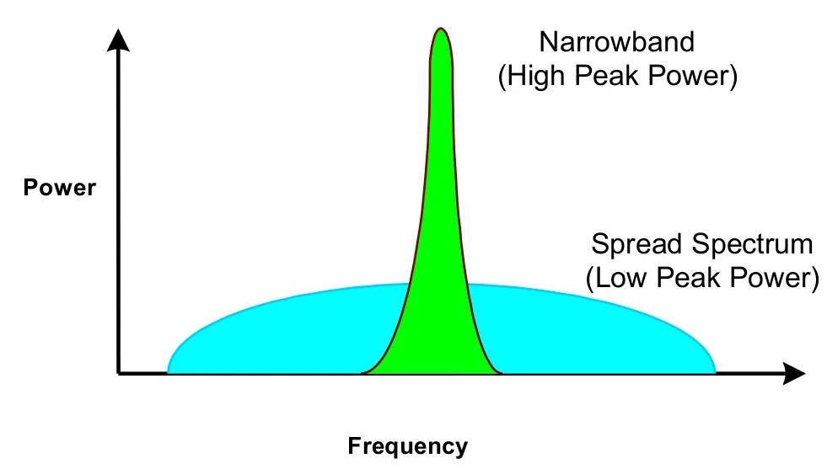
How to Create LPI/LPD Waveforms
Lower the Power (at Willie)
Spread it out in frequency

Slide 25
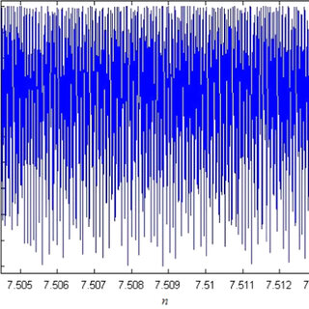
How to Create LPI/LPD Waveforms
Lower the Power (at Willie)
Spread it out in frequency
Make the waveform irregular

Slide 26
Spread Spectrum
Frequency Hopping
(FHSS)
Chirp Spread Spectrum
(CSS)
Direct Sequence (DSSS)

Slide 27
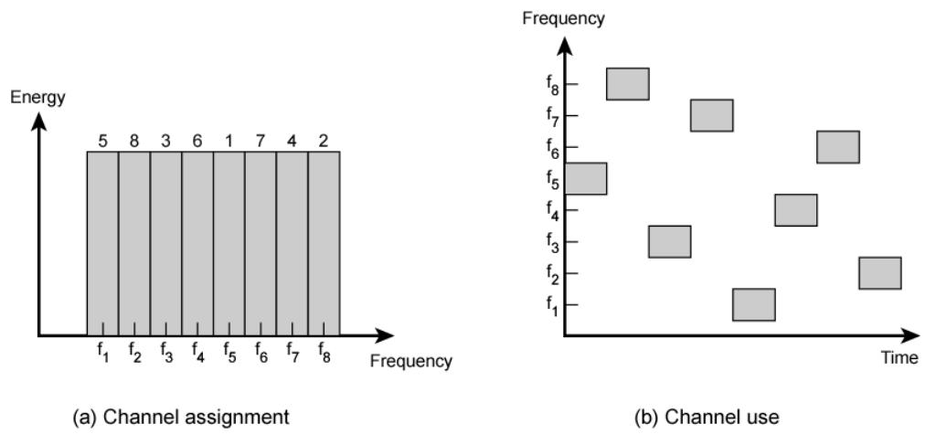
Frequency Hopping Spread Spectrum

Slide 28
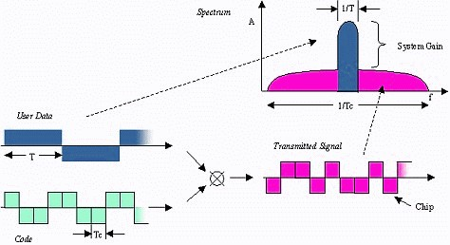
Direct Sequence Spread Spectrum
Multiply signal
by spreading sequence
Flattens
frequency
spectrum

Slide 29
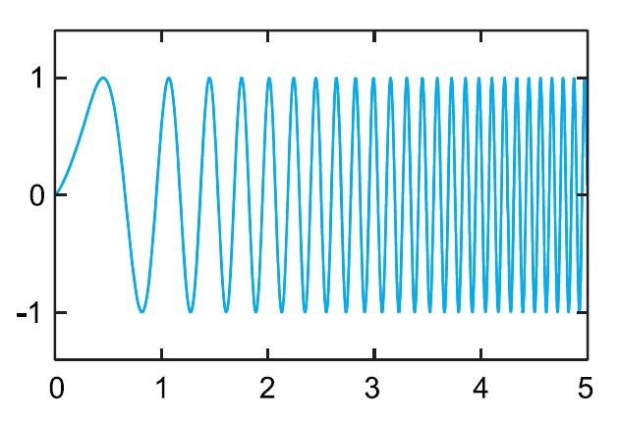
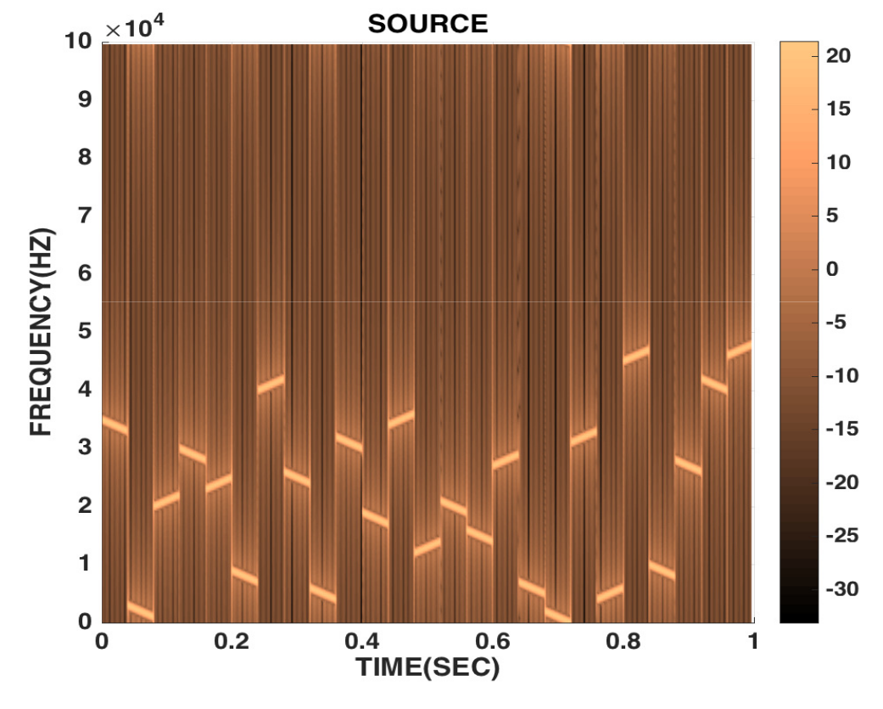
Chirp Spread Spectrum
Direction and
slope can encode
information
Immune to
Doppler shift

Slide 30
Chaos Communications
A small change to the initial conditions results in a large change to the output.
Chaos provides an irregular waveform
Presents synchronization issues

Slide 31
The Situation

Slide 32
The Situation
Fundamental limits established mathematically

Slide 33
The Situation
Fundamental limits established mathematically
Several methods of increase “covertness”

Slide 34
The Situation
Fundamental limits established mathematically
Several methods to increase “covertness”
No way to evaluate covertness

Slide 35
The Situation
Fundamental limits established mathematically
Several methods of increase “covertness”
No way to evaluate covertness
No way to generate optimal covert protocol

Slide 36
Thesis Question(s)

Slide 37
Thesis Question(s)
What detection method(s) can Willie employ to best detect LPI/LPD signals?

Slide 38
Thesis Question(s)
What detection method(s) can Willie employ to best detect LPI/LPD signals?
Which protocols and techniques can Alice employ to best evade detection (while communicating with Bob with a given probability of error)?

Slide 39
Thesis Proposal
Create simulation of channel
Evaluate which techniques increase covertness (while maximizing transmission rate)
Evaluate which detector(s) work best

Slide 40
Detectors Available to Willie
Wideband Radiometer (Energy)
D’Agostino and Pearson’s Normal Test
Max Cut Detector (Cyclostationary)
Degree of Cyclostationarity (Cyclostationary)

Slide 41
Detectors Available to Willie
✅ Wideband Radiometer (Energy)
✅ D’Agostino and Pearson’s Normal Test
✅ Max Cut Detector (Cyclostationary)
✅ Degree of Cyclostationarity (Cyclostationary)

Slide 42
Protocols Available to Alice and Bob
Traditional:
  PSK
  FSK
  QAM
Spread Spectrum
  CDMA
  OFDM
  FH-CSS
Chaotic
  Chaotic Multi-Tone (CMT)
  Differential Chaos Shift Keying (DCSK)
  FH-OFDM-DCSK
Other
  QS-DS-CDMA

Slide 43
Protocols Available to Alice and Bob
Traditional:
  ✅ PSK
  ✅ FSK
  ✅ QAM
Spread Spectrum
  ✅ CDMA
  ✅ OFDM
  FH-CSS
Chaotic
  Chaotic Multi-Tone (CMT)
  ✅ Differential Chaos Shift Keying (DCSK)
  ✅ FH-OFDM-DCSK
Other
  QS-DS-CDMA

Slide 44
Questions?

Slide 45
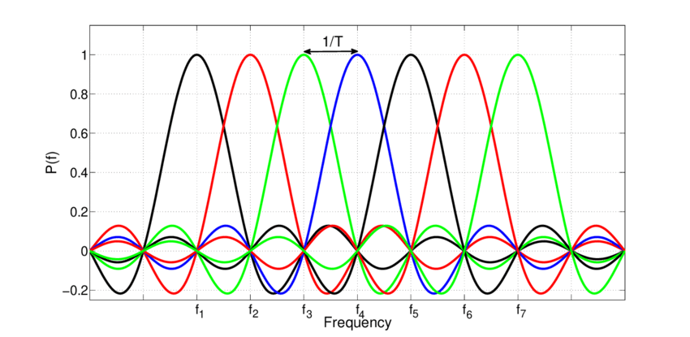
OFDM
Multiplex bits across orthogonal subcarriers
Flattens
frequency
spectrum
Helps mitigate
FSF

Slide 46
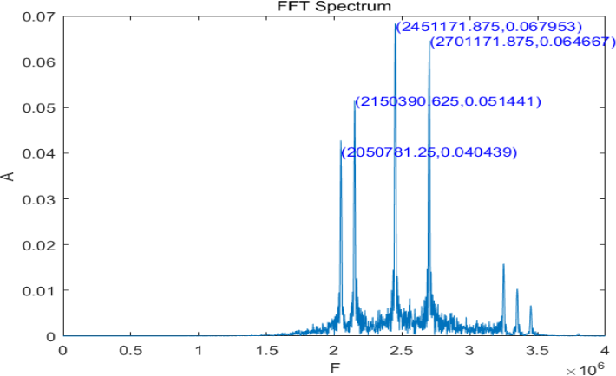
Chaotic Multi Tone
Chaotically select
tone groups to
transmit information
Signal is very
random

Slide 47
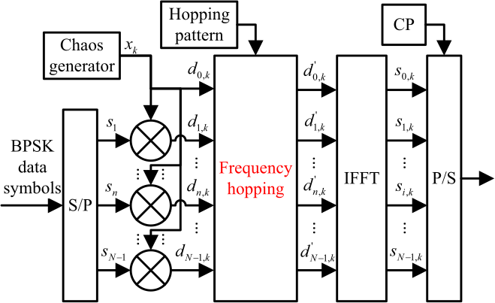
FH-OFDM-DCSK
Frequency Hopped OFDM Differential Chaos Shift Keying

Slide 48
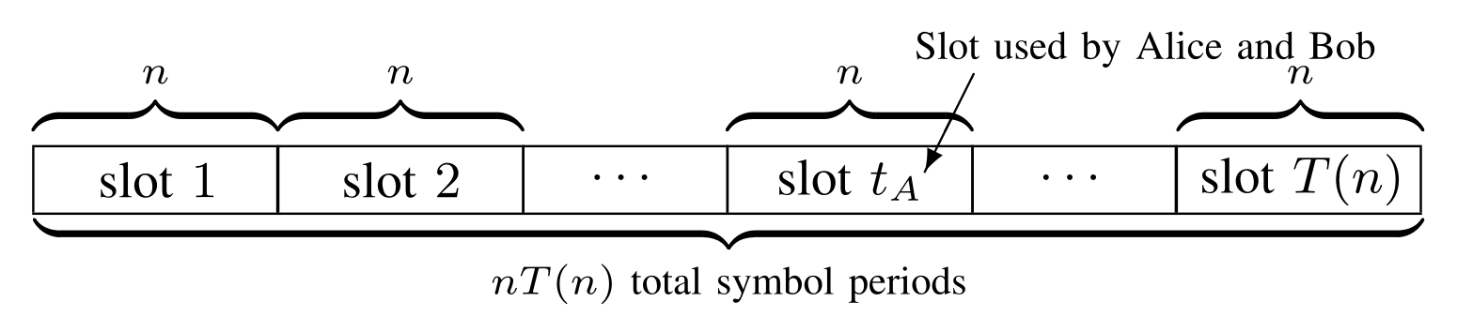
When Willie Doesn’t Know When
Alice picks one slot out of T(n) slots
She can transmit O(√n log(T(n))) bits
Willie has to monitor every slot.

